Slide 1
Design and Fabrication of Interactive Autonomous Robot as a Research Platform : Robomuse3.0
Supervisor : Prof. S.K. Saha
Examiner : Prof. S. Mukherjee
By : Vishal Mehta : 2010ME10693
Gaurav Kumar : 2010ME10673

Slide 2
Objective
Develop a 24x7 operational, autonomous mobile robot for industrial use (ROBOMUSE 3.0)
Study of previous development in this direction at IIT Delhi
Eliminate problems existing in previous design of ROBOMUSE
Make a detailed CAD model of improved version ROBOMUSE 3.0
Dynamic simulation of robot using RecurDyn
Benchmarking with contemporary mobile robots in market
Fabricate mechanical structure of robot
Achieve 90% reliability and low maintenance

Slide 3
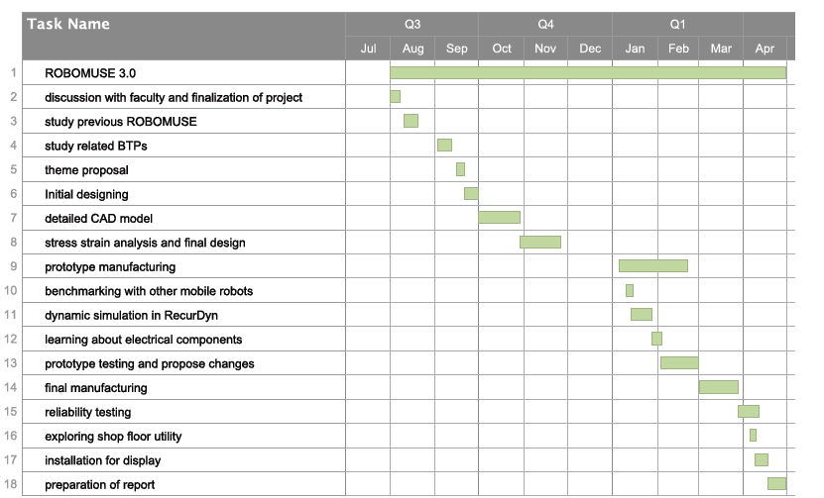
Gantt Chart

Slide 4
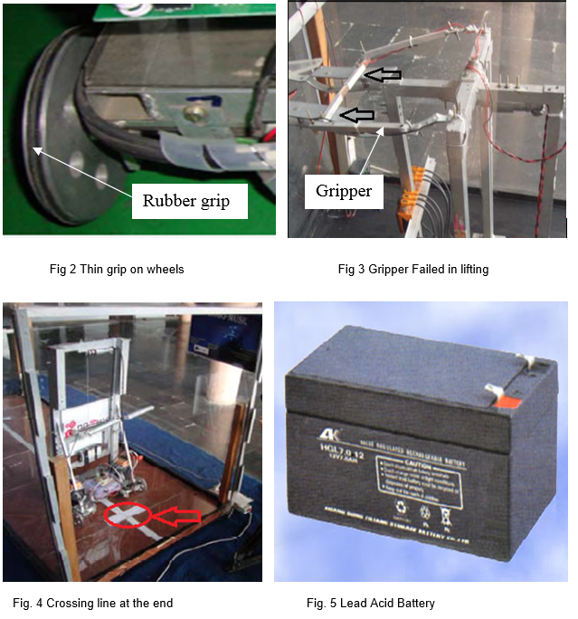
Work Done (Part 1)
Study prior attempts in this direction at IIT Delhi
Identify all possible problems and sources of error and eliminate them
Mechanical problems
Electrical problems
General problems

Slide 5
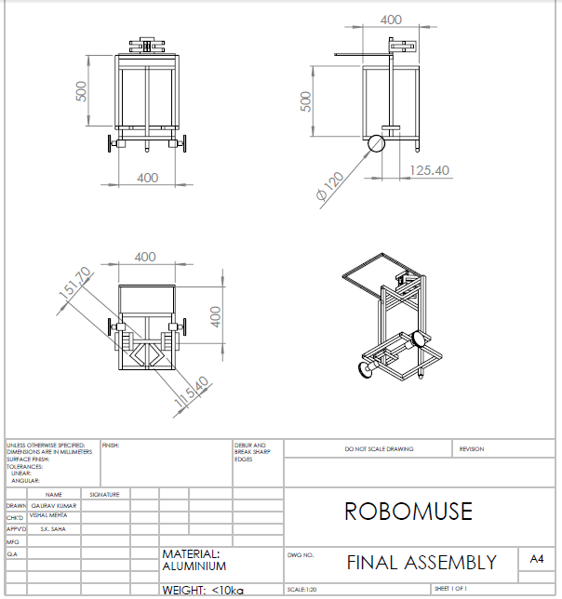
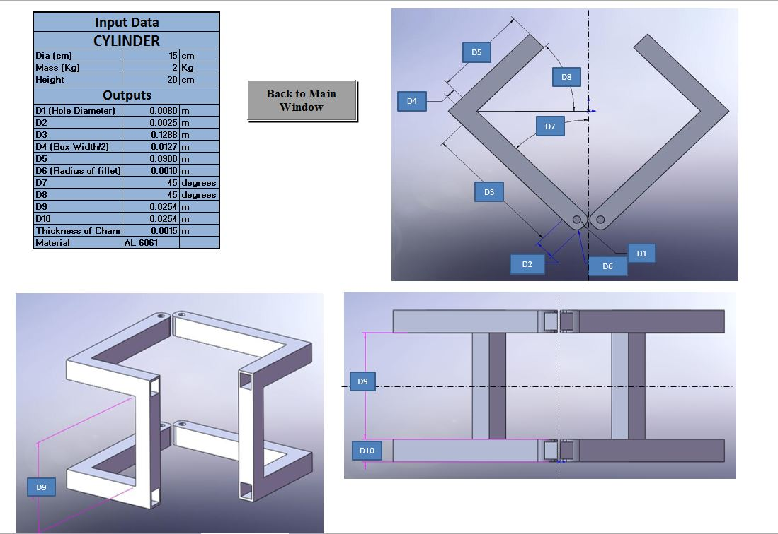
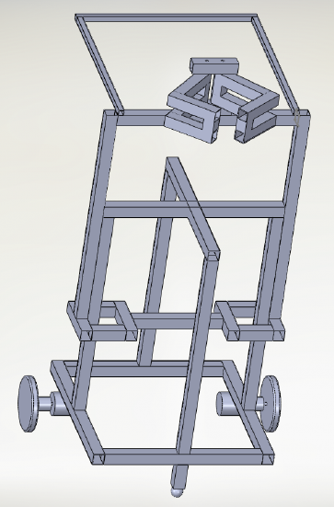
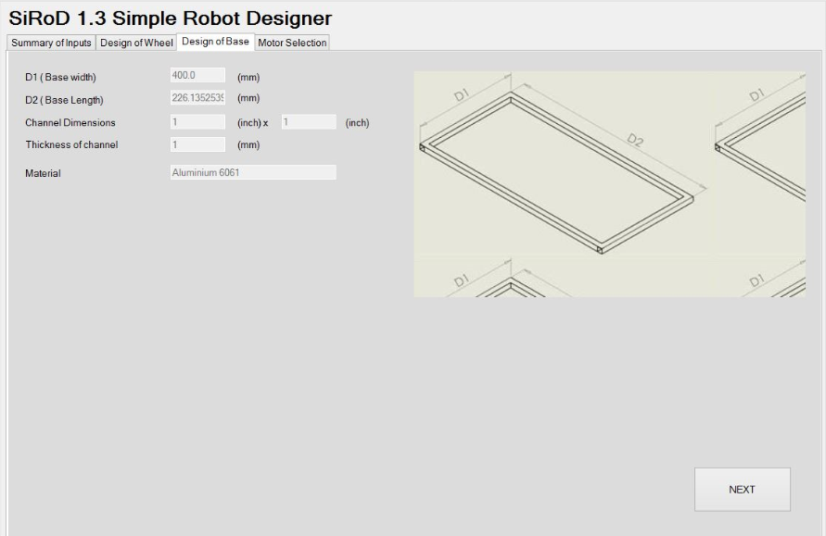
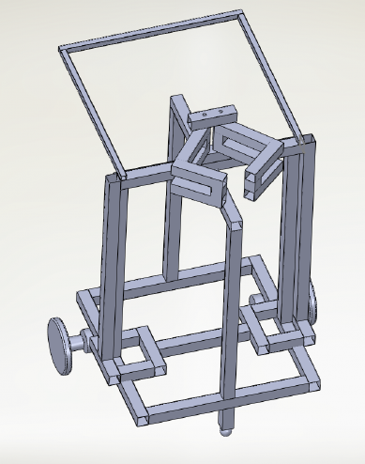
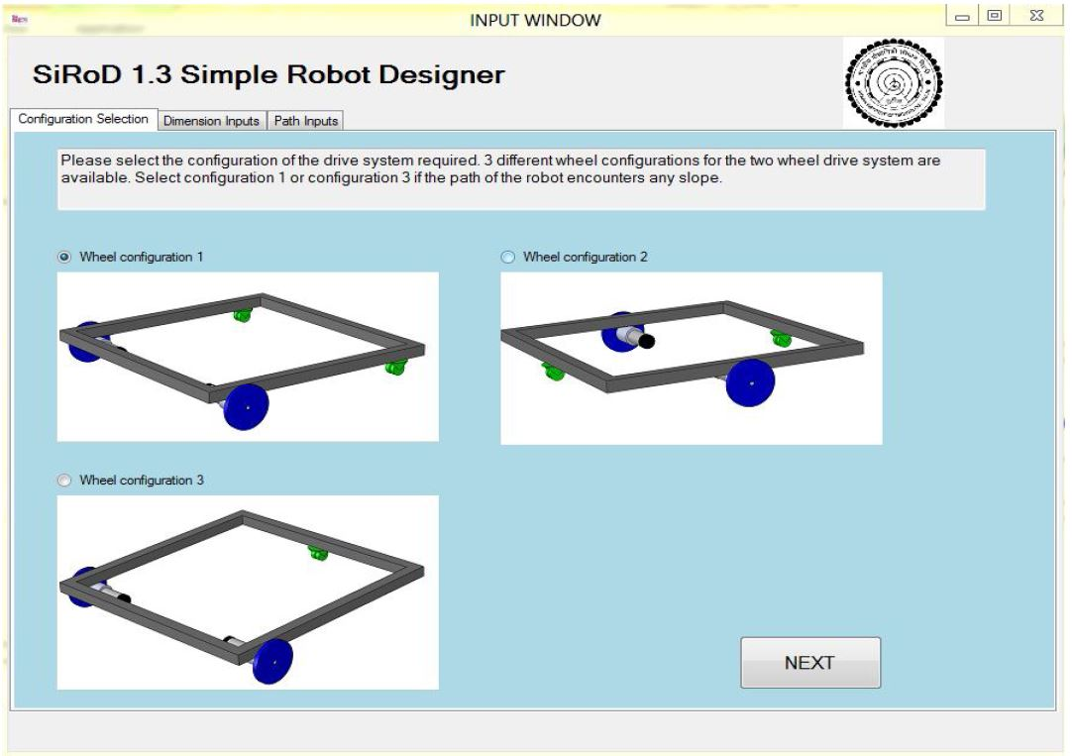
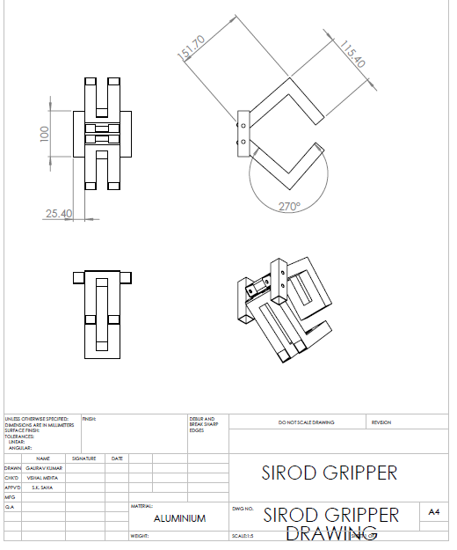
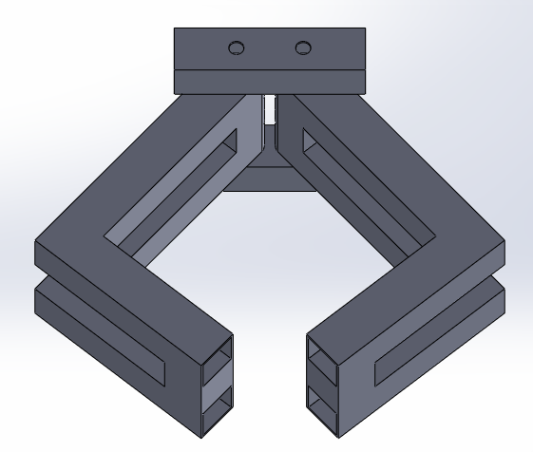
Work Done (Part 1)
Studied BTP reports on gripper design and base dimension to avoid toppling
Designed gripper using software SIROD 2.0
Made CAD model of gripper
Performed toppling analysis using software SIROD 2.3
Made CAD model of previous ROBOMUSE with new gripper

Slide 6
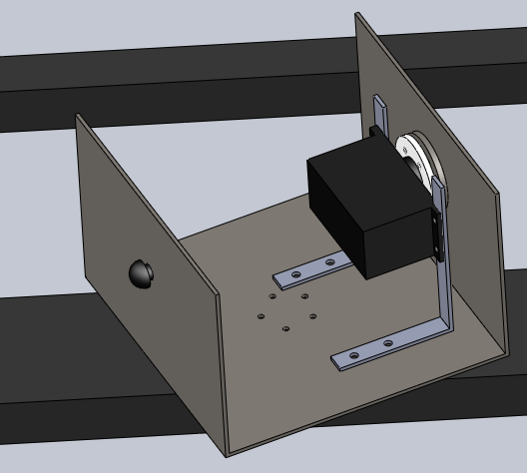
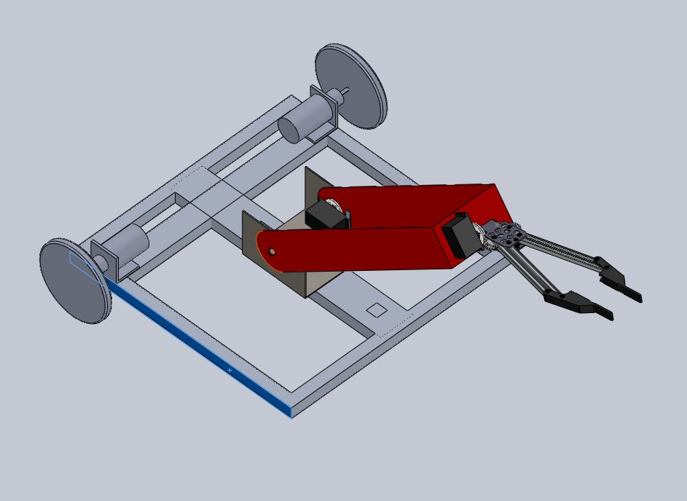
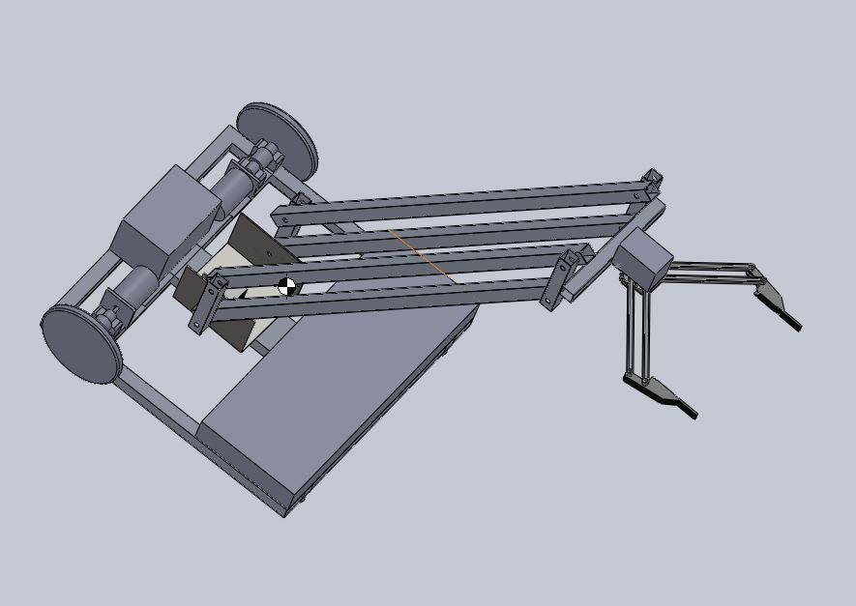
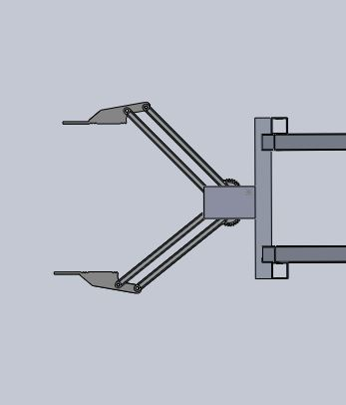
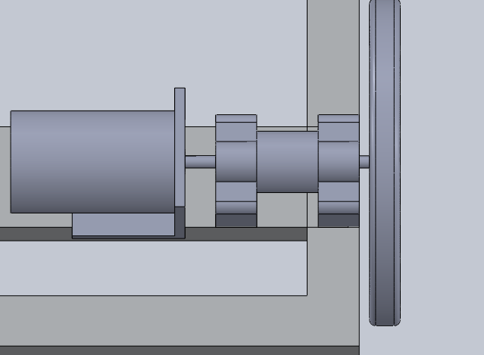
Work Done (Part 1)…
Designed gripper with:
Smaller footprint
Chamfered exterior fingers
Minimum finger length
Designed two different gripper arms
Turn-table for moving arm
Motor mounting using two bearings and spring coupler
Theoretically calculated torque and RPM requirement of motors

Slide 7
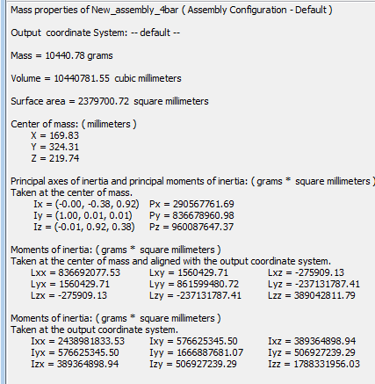
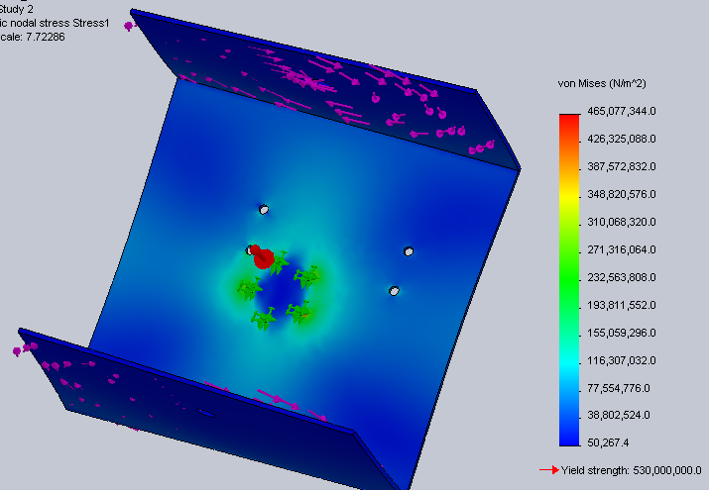
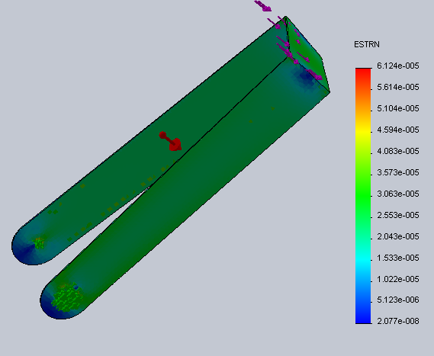
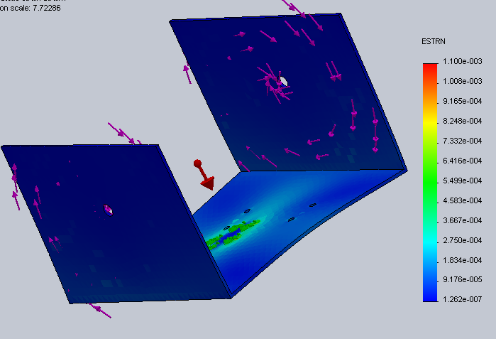
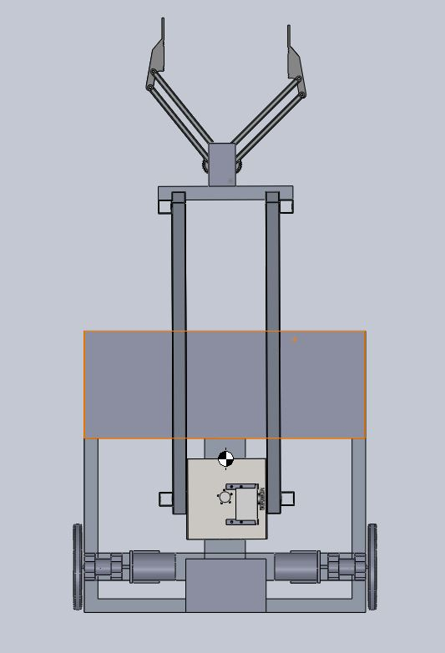
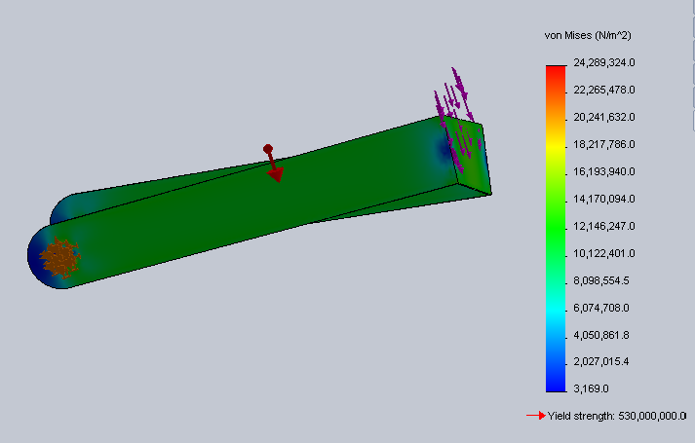
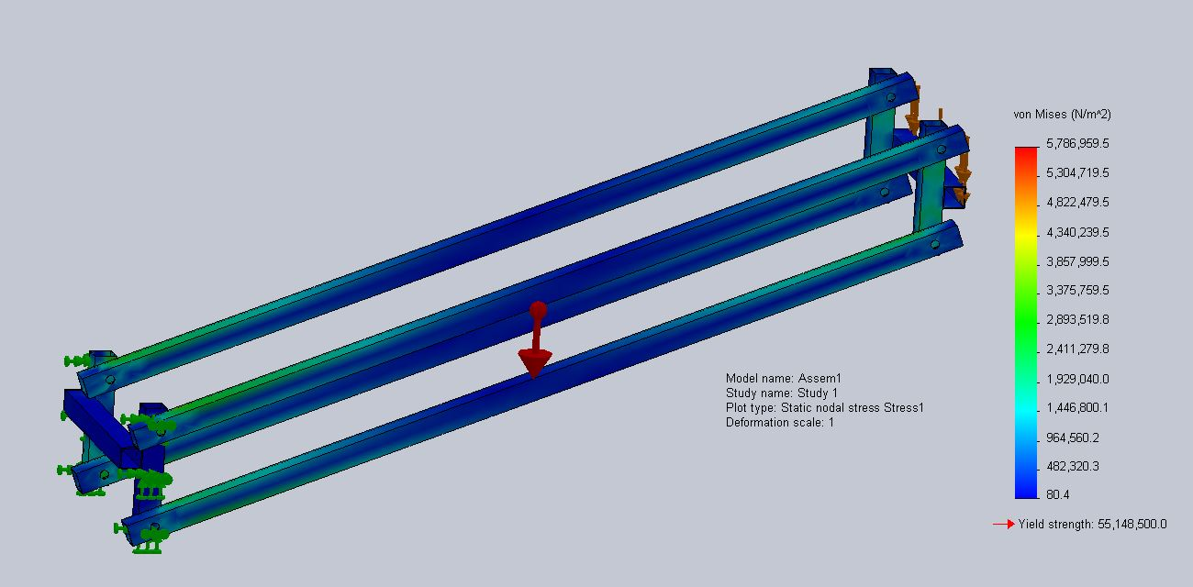
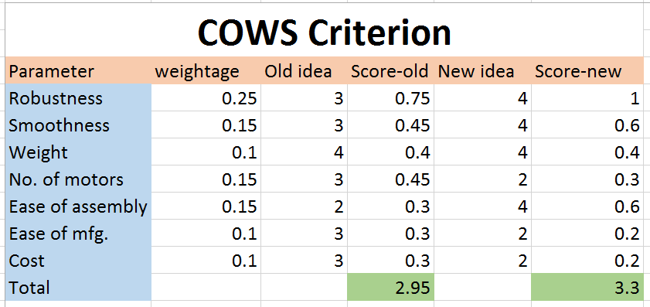
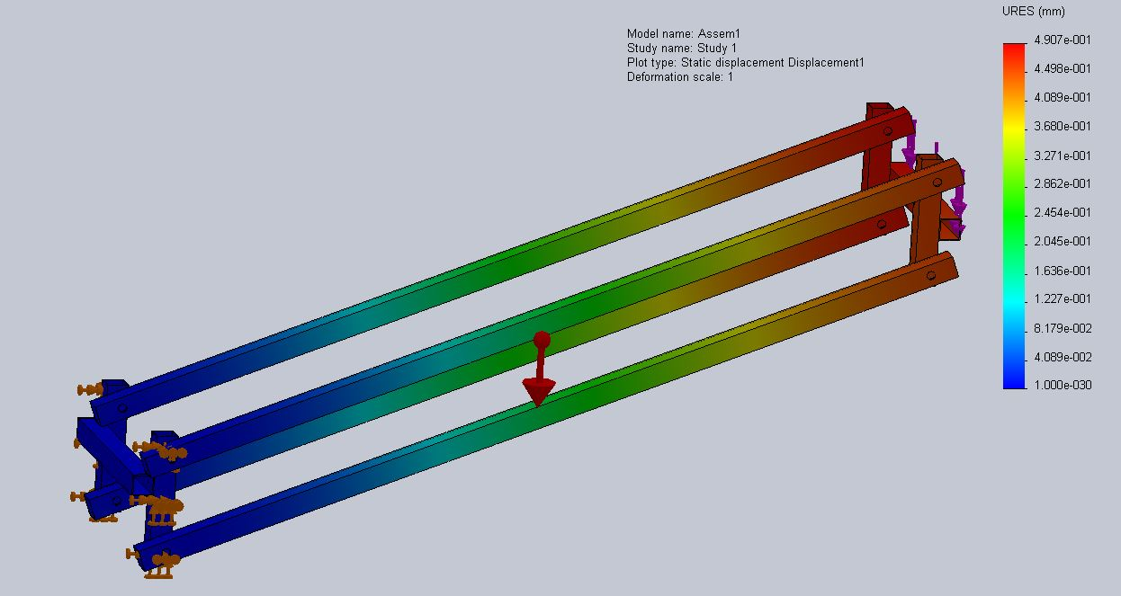
Work Done (Part 1)
Calculated mass properties, centre of mass & moments of inertia using CAD
Stress-strain analysis of critical parts in Solidworks
Finalized material and obtained FOS
Applied COWS method for finalizing design:

Slide 8
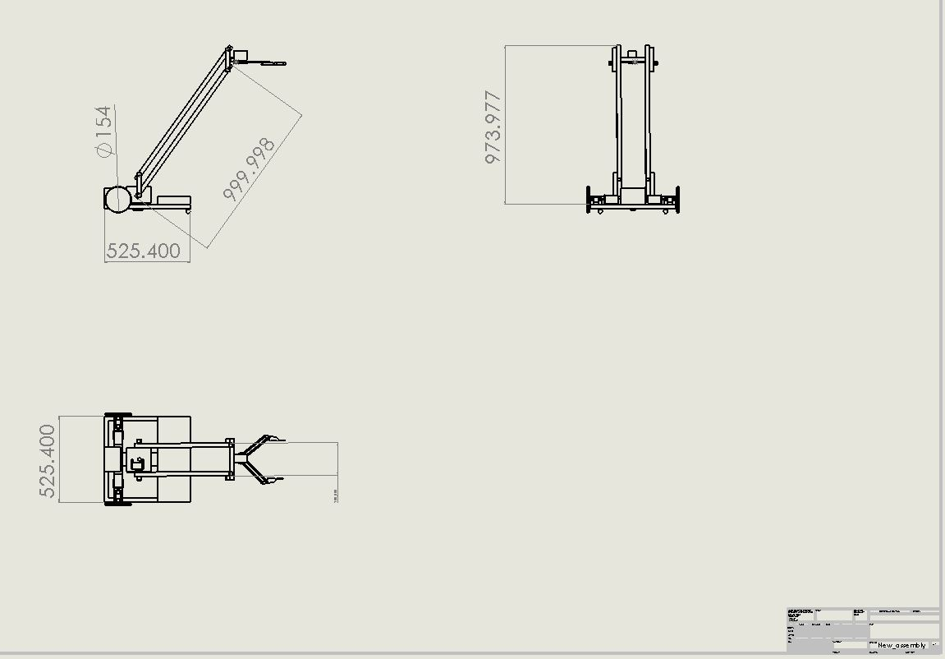

Slide 9
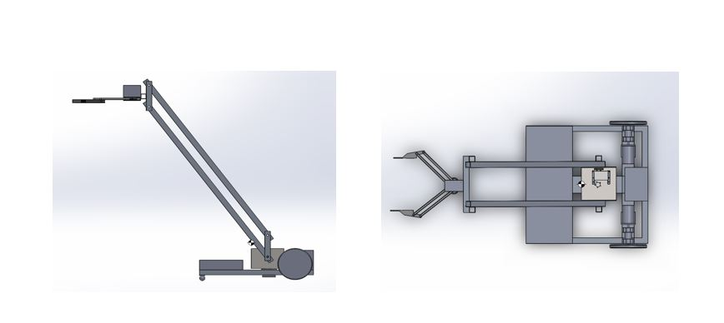

Slide 10
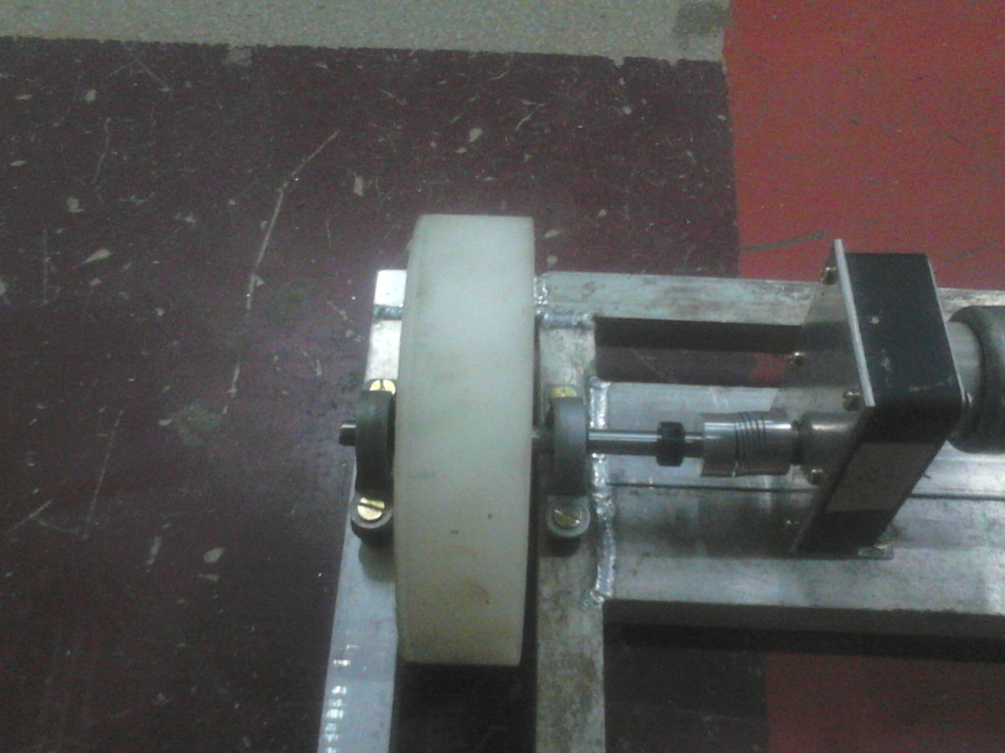
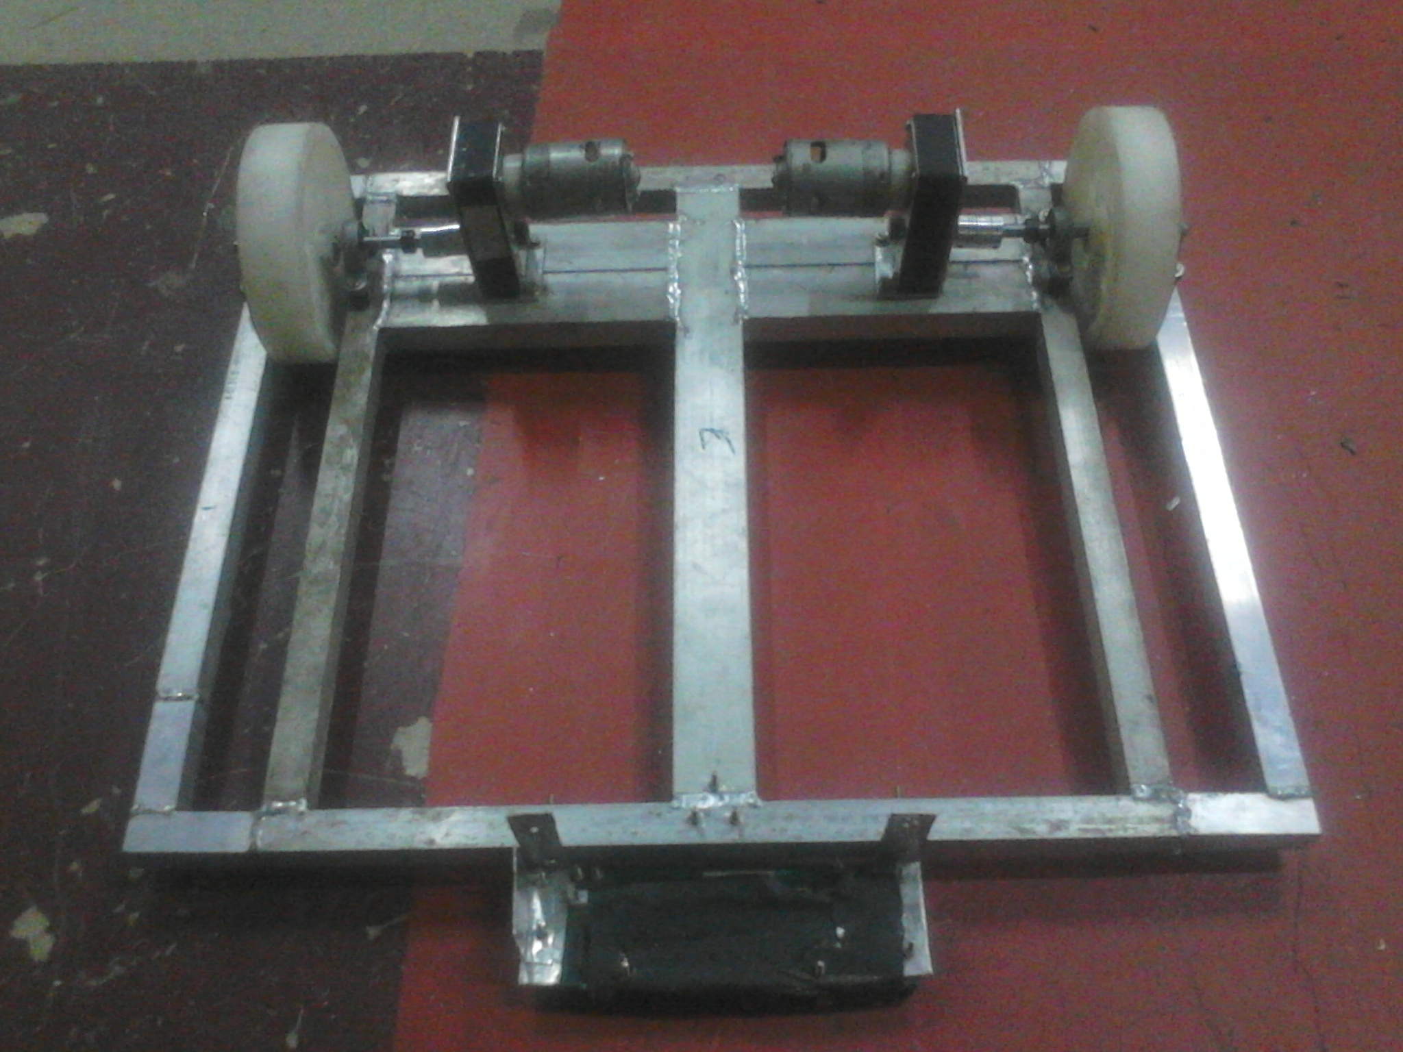
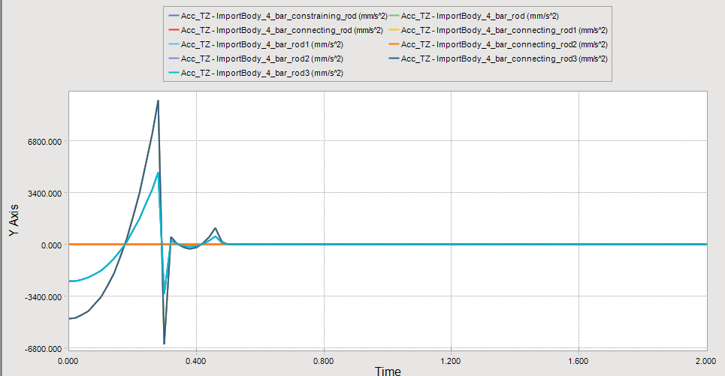
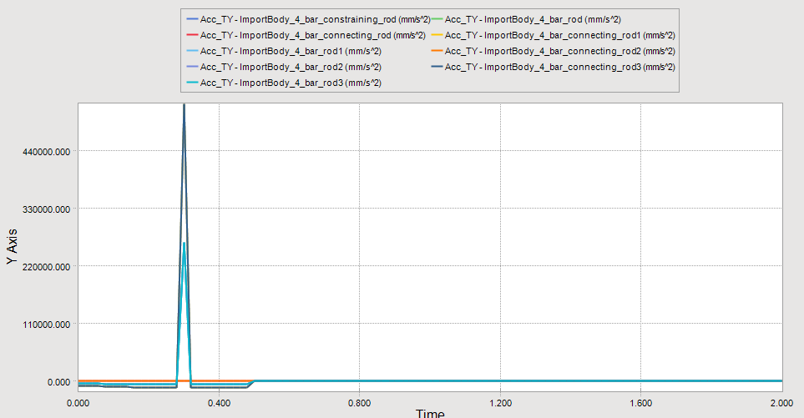
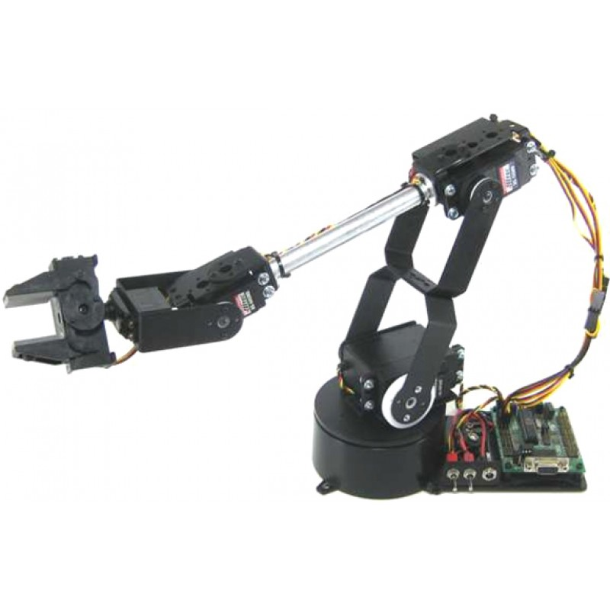
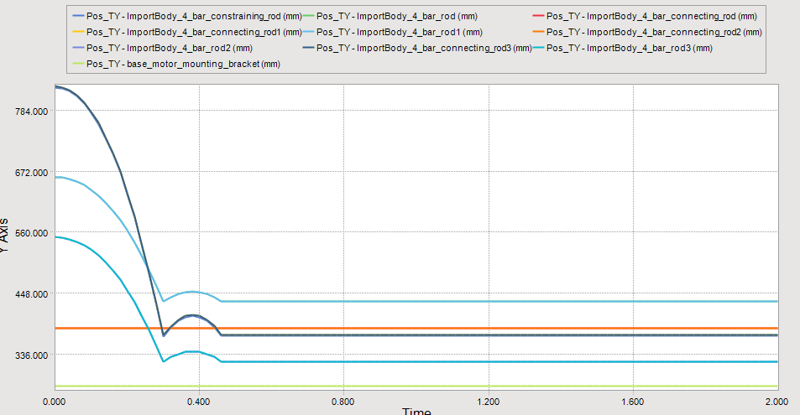
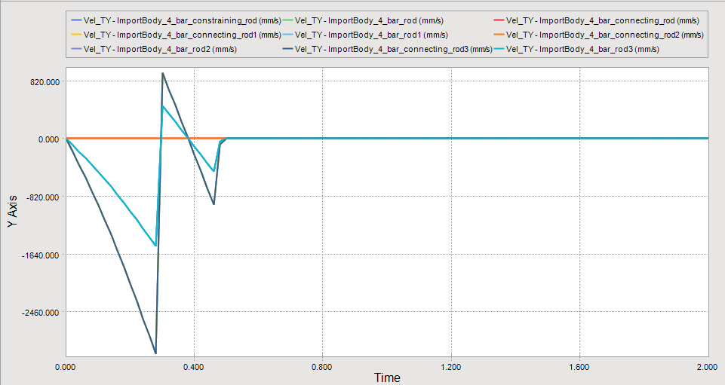
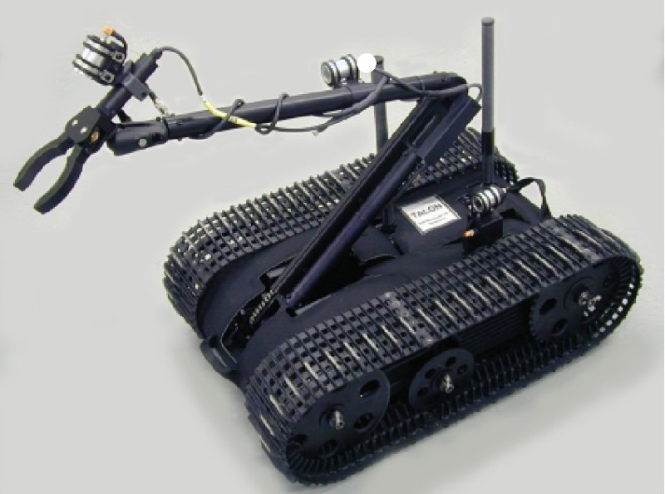
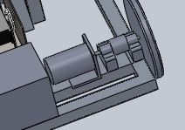
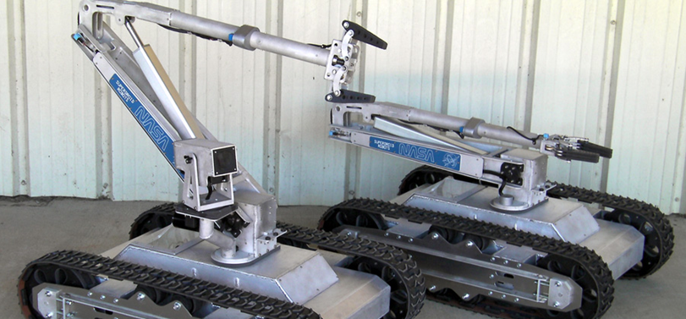
Progress Made in Part 2
New design of motor mounting using two bearings for support
Simulation of grippers under gravity in RecurDyn
Similar robots in market
Manufacturing of robot base
Running driving motors using Sabertooth motor driver
Attached OPT sensors for line following
Line following code compilation using micro controller ARDUINO
Simulation of how robot working in arena

Slide 11
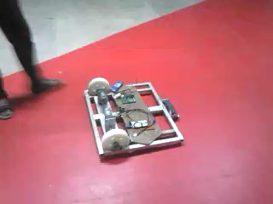
Base testing

Slide 12
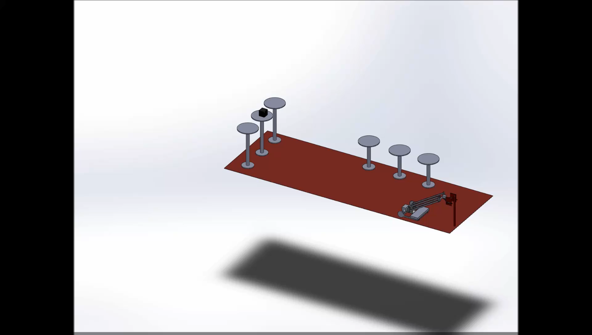

Slide 13
THANK YOU

